Slide 1

Linux Privilege Escalation Toolkit
Modular detection toolkit for safe Linux privilege enumeration
Author: Om Fulsundar

Slide 2



Abstract
A modular, detection-focused toolkit designed for comprehensive Linux privilege escalation enumeration. The system performs read-only inspection of critical system components including SUID/SGID binaries, file permissions, cron jobs, systemd services, sudo rules, and kernel vulnerabilities.
Produces structured JSON logs for each module alongside a consolidated human-readable report. All checks are read-only with no exploit execution, making it suitable for security audits and production environments.
Detection Focused
Modular Design
Structured Output
Read-only enumeration only
Independent, extensible modules
JSON logs + human-readable report

Slide 3
Project Objectives
01
02
Automate Detection
Structured Logging
Automatically identify common privilege escalation vectors across Linux systems without manual intervention
Generate machine-readable JSON logs and consolidated human-readable reports for easy analysis
03
04
Modular Architecture
Safe Operation
Maintain independent, easily extensible modules that can be updated or expanded without breaking the system
Ensure read-only checks only, making the toolkit suitable for security audits and production environments

Slide 4

High-Level Pipeline
main.py initialization
kernel_scan
The toolkit orchestrates multiple detection modules in parallel, consolidating findings into comprehensive reports.
Produces JSON output
Creates results directory
cron_scan
Pipeline Overview
suid_scan
Produces JSON output
Produces JSON output
services_scan
perms_scan
Produces JSON output
Produces JSON output
Internal process from initialization to final report generation

Slide 5
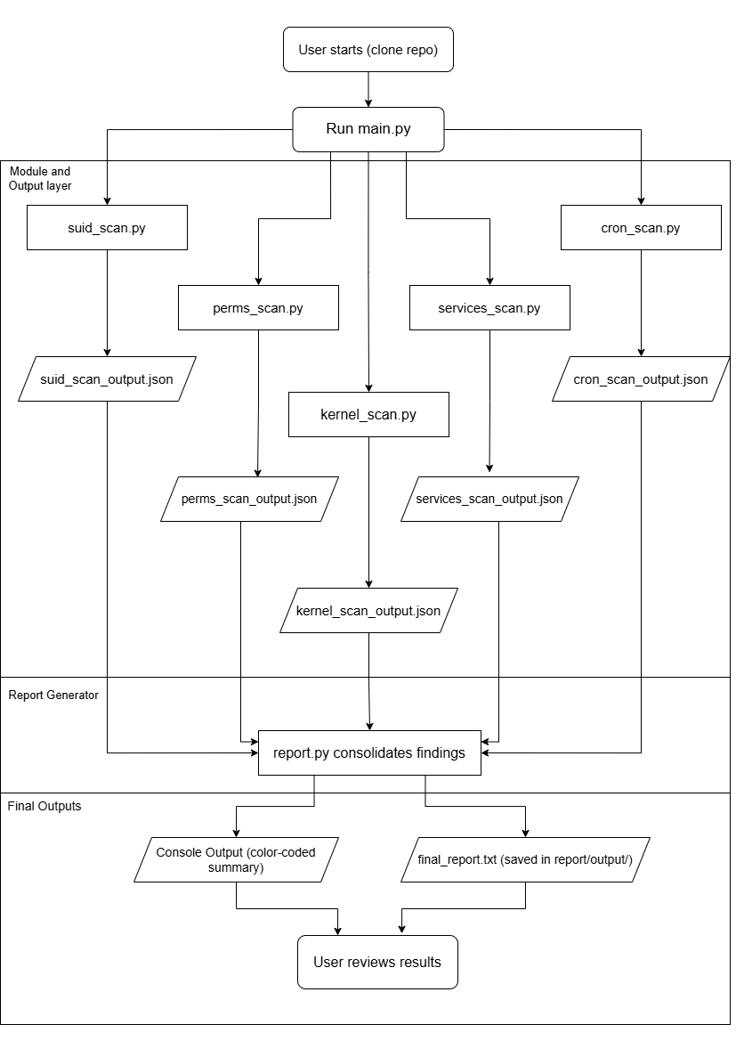





User Workflow
A straightforward, five-step process designed for ease of use by security engineers and auditors.
Clone Repository
Download toolkit source code
Execute Main Script
Run python3 main.py
Modules Run
Parallel detection scans
Report Consolidation
Findings combined and formatted
Review Results
Analyze terminal + report.txt

Slide 6
Module Responsibilities
suid_scan.py
cron_scan.py
kernel_scan.py
Enumerates SUID and SGID binaries across the filesystem, identifying executables with elevated privileges
Aggregates cron entries from system and user crontabs, checking script permissions and execution contexts
Captures kernel version and architecture, mapping against known CVE databases for vulnerability identification
perms_scan.py
Detects world-writable files and directories owned by root, highlighting potential privilege escalation paths
services_scan.py
Inspects systemd units and sudo rules to identify misconfigurations and excessive privileges

Slide 7
Data and Outputs
Output Structure
Directory Layout
Each module generates structured JSON containing summary statistics and detailed findings with paths, descriptions, severity levels, and evidence.
report/ ├── output/ │ ├── suid_scan_output.json │ ├── perms_scan_output.json │ ├── services_scan_output.json │ ├── cron_scan_output.json │ ├── kernel_scan_output.json │ └── final_report.txt
The consolidated final_report.txt provides human-readable analysis with color-coded terminal summary for rapid triage.

Slide 8





Key Commands and Safe Behavior
Clone Repository
git clone [https://github.com/Om-Fulsundar/linux_privesc]
Run Toolkit
cd linux_privesc
python3 main.py
Safe Execution
All checks are read-only; no exploits executed
Isolated Testing
Use VMs or containers for testing

Slide 9
Testing Environments and Evaluation
Test Environments
Strengths and Limitations
Parrot OS / Kali
Ubuntu Server
Strengths
Modular, safe architecture
Structured JSON outputs
Easy extension and integration
Richer default findings due to security tool installations
Clean baseline for comparison testing
Limitations
Docker Containers
Implemented checks only
Static kernel CVE mapping
Local execution mode only
Isolated, repeatable test environments

Slide 10
Conclusion and Roadmap
Current Foundation
Toolkit provides safe, modular foundation for privilege enumeration with structured outputs supporting audits and remediation workflows
Future Enhancements
Expand detection paths, integrate live CVE feeds, improve sudo parsing, and add interactive reporting interface
Next Steps
Expand detection coverage, implement real-time vulnerability databases, and enhance user experience with interactive reporting
References
GTFOBins public knowledge base
Linux system documentation (systemd, cron, permissions)
Public CVE databases
Screenshots and sample outputs included in repository's screenshots folder

Slide 11
Thank You !

